Slide 1


V.S.B. ENGINEERING COLLEGE,KARUR
(AN AUTONOMOUS INSTITUTION, AFFILIATED TO ANNA UNIVERSITY)
DEPARTMENT OF INFORMATION TECHNOLOGY
Integrating Computer Vision And Deep Learning For Automated Object Diagnosis And Repair
Guided By:
Mrs.Nandhini.I (AP/IT)
Team Members:
Vishnu.T
Thirumalaivasan.S
Yugith.M
Titus Raj.R

Slide 2
Abstract
Automates defect detection using AI to reduce human error and ensure accurate analysis in industrial and personal use.
Recommends reliable repair methods with required tools and clear step-by-step instructions for proper execution.
Educates users about the material types and correct working techniques, helping them identify fake or unnecessary repair actions by untrustworthy workers.
Empowers users with knowledge to make informed decisions, reducing dependency on manual labor and preventing scams.
Accessible via mobile and web platforms, making it easy for anyone to diagnose issues and perform guided repairs confidently.

Slide 3
Introduction
The project focuses on integrating Computer Vision and Deep Learning to automate defect detection and repair processes across various materials and objects.
It aims to identify defects such as cracks or damages in real-time and recommend accurate repair solutions using AI models like YOLO and CNN.
The system can quickly identify cracks in phone screens or damages in household appliances, allowing users to take timely action.
The system helps users understand material types and correct working methods, reducing the chances of being misled by false or unnecessary repair claims.
Developed using Python and Django, the framework offers a web-based and mobile-accessible platform for easy defect diagnosis and guided repair actions
The core objective is to minimize manual inspection errors, lower material wastage, and empower both industrial and general users with trustworthy, AI-driven repair guidance.

Slide 4
Literature Review
S No
Title
Author(s)
Year
Gap Identifications
1
Data-Driven Methods for Predictive Maintenance of Industrial Equipment
Zhang, W., Yang, D., & Wang, H.
2019
Focused on large-scale industries lacks adaptation for household-level systems.
2
Machine Learning and Deep Learning Based Predictive Quality in Manufacturing: A Systematic Review
Tercan, H., & Meisen, T.
2022
Not designed for real-time, consumer-level damage detection.
3
Vision-Based Damage Localization for Robotic Repair
Imam, H.Z., Al-Musaibeli, H., Zheng, Y., & Ahmad, R.
2023
Limited to robotic systems lacks accessibility for non-industrial users.

Slide 5
S No
Title
Author(s)
Year
Gap Identifications
4
Real-Time Surface Defect Inspection Using Deep Learning
Liu, Y., Zhang, C., & Dong, X.
2023
Restricted to metal surfaces; lacks multi-material and practical deployment support.
5
DeepInspect: An AI-Powered Defect Detection for Manufacturing Industries
Kumbhar, A., Chougule, A., Lokhande, P., et al.
2023
Lacks predictive maintenance capabilities for long-term industrial automation.

Slide 6
EXISTING SYSTEM
1
Data Limitations
Deep learning models require large and diverse datasets for training, but collecting and labeling defect images is a time-consuming and labor-intensive process. This limits the system's ability to learn from real-world defects effectively
2
Real-Time Processing
The high computational demands of deep learning models make real-time defect detection challenging. Processing complex images requires powerful hardware, which may not be feasible for all users.
3
Generalization Issues
Models trained on specific defect types may not perform well on new or unseen defects. Variations in materials, lighting conditions, and object structures can impact accuracy, reducing reliability in real-world scenarios.
4
Integration with Existing Systems
Many users and businesses still rely on traditional repair methods and legacy systems, making it difficult to integrate AI-driven defect detection seamlessly. Compatibility issues can slow down adoption and limit accessibility.

Slide 7
PROPOSED SYSTEM
To overcome the limitations of existing methods, this project introduces an AI-driven automated defect detection and repair system that enhances accuracy and efficiency.
1
Real-Time Image Capture
The system captures object images in real-time using a camera or smartphone, ensuring quick and efficient defect identification.
2
Deep Learning-Based Defect Detection
Utilizing CNN models like YOLO and Faster R-CNN, the system analyzes images to detect defects with high precision, minimizing errors in identification.
3
Defect Classification
Detected defects are categorized based on severity, helping users differentiate between minor, moderate, and critical damages.
4
Repair Recommendation System
Based on the classification, the system suggests optimal repair strategies using a knowledge-based AI model, enabling informed decision-making.
5
Web-Based Dashboard
A user-friendly dashboard provides real-time monitoring of defect detection, classification, and recommended solutions, making it accessible from any
device.

Slide 8
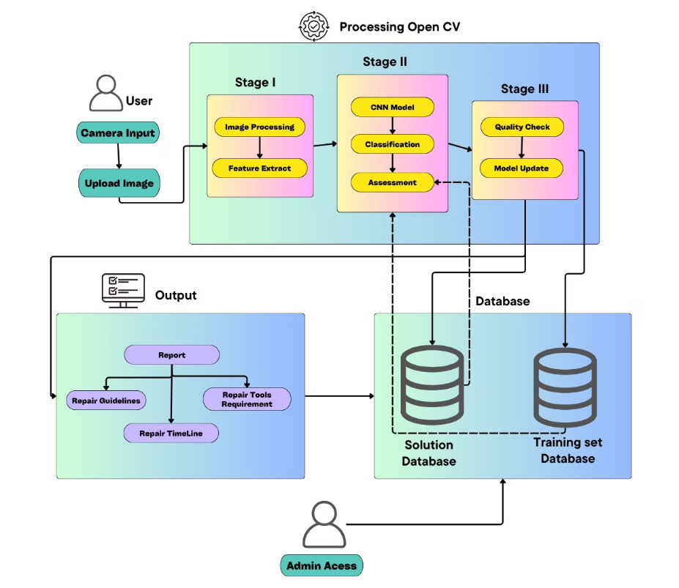
System Architecture Overview

Slide 9



List of Modules
User Interaction Module
Image Processing & Feature Extraction (Stage I)
Defect Detection & Classification (Stage II)
Users capture or upload object images through a camera input system.
Image Processing: Prepares the input image by enhancing quality, reducing noise, and performing necessary transformations.
CNN Model: Uses deep learning to analyze extracted features and detect defects.
The images are then sent for processing.
Classification: Categorizes defects based on severity and type.
Feature Extraction: Identifies critical visual characteristics, such as texture, shape, and defects, for further analysis.
Assessment: Evaluates defect impact and determines necessary actions.

Slide 10




Model Optimization & Quality Check (Stage III)
Database Management
Quality Check: Ensures defect detection accuracy and flags incorrect predictions.
Training Set Database: Stores labeled images for improving AI model performance.
Model Update: Refines the CNN model using feedback and new training data.
Solution Database: Maintains defect classification records and corresponding repair solutions.
Output & Repair Recommendations
Admin Access
Report Generation: Provides users with defect analysis results.
Enables monitoring, model updates, and management of system operations.
Repair Guidelines: Suggests corrective actions and repair tools.
Repair Timeline: Estimates time required for defect resolution.

Slide 11
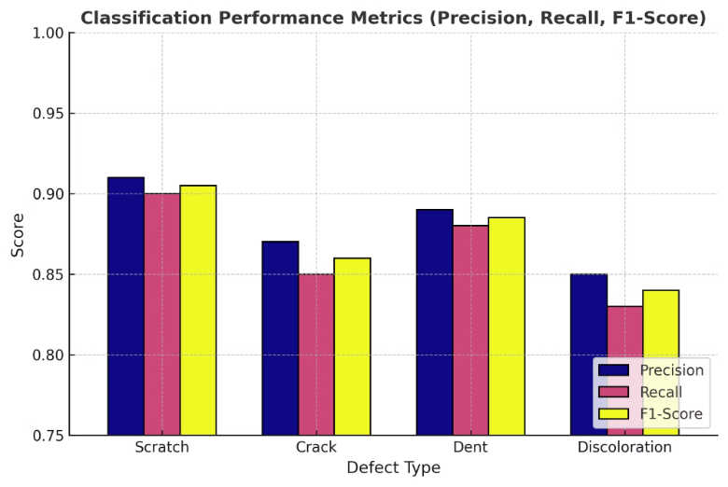
Result and Analysis of Defect Detection
Classification Performance Metrics (Precision, Recall, F1-Score)

Slide 12
Conclusion
This project presents an AI-powered solution for defect detection and repair automation using computer vision and deep learning techniques like YOLO and CNN. The system accurately detects damages in various materials—such as cracked phone screens and household items—and provides real-time repair suggestions, reducing the need for expert intervention.
By offering detailed repair guidance, tool requirements, and method awareness, the system helps prevent repair scams and empowers users with the knowledge to perform safe, effective fixes. The integration of a web-based interface ensures accessibility and usability for both general users and industrial applications.
Overall, the project enhances efficiency, minimizes material waste, and brings intelligence to the repair process, marking a step forward in practical, AI-driven defect management.
Future research directions include refining the model for more complex defect types, expanding its applicability to diverse industrial settings, and integrating advanced robotic repair systems. Ultimately, our goal is to revolutionize industrial automation by providing a reliable, AI-powered solution for defect detection and repair.

Slide 13
Future Enhancements
Enhancing Defect Classification – Implementing transformer-based models like Vision Transformers (ViTs) for improved defect classification accuracy.
Integrating Augmented Reality (AR) – Using AR for real-time defect visualization, aiding technicians in precise
repairs.
Expanding the Dataset – Incorporating diverse object defect scenarios for better generalization across industries.
Implementing Reinforcement Learning – Enabling adaptive defect diagnosis by continuously improving model performance based on feedback.
Integrating IoT for Automated Repairs – Connecting the system with IoT-enabled robotic arms to perform minor automated repairs based on defect analysis.

Slide 14
References
You Only Look Once: Unified, Real-Time Object Detection (2016)
Faster R-CNN: Towards Real-Time Object Detection with Region Proposal Networks (2015)
SSD: Single Shot MultiBox Detector (2016)
Deep Residual Learning for Image Recognition (2016)
A Real-Time Automated Defect Detection System for Manufacturing (2023)
A Review on Vision-Based Defect Recognition for Industrial Intelligence (2022)
Patent & Publication Status:
The patent filing process is currently in progress to secure intellectual property rights for the system.
The research paper has been applied and is under review for publication in a reputed journal/conference.

